Slide 1
CGPA CALCULATOR
Subject: PPS
PROJECT BASED LEARNING
By Sarvesh Kasar
Krish Chand
Ayush Mule
Arav Desai

Slide 2
Introduction
We have made a CGPA Calculator.
The CGPA Calculator can calculate in three different ways as per choice and convenience .
semester wise CGPA
Grade & credit wise CGPA
Subject wise CGPA

Slide 3
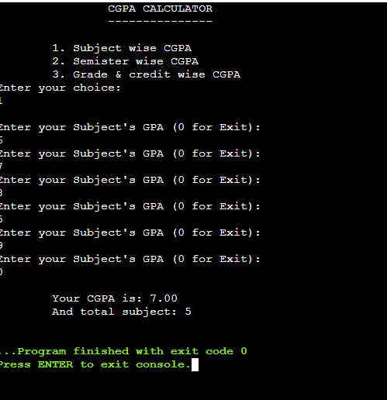
explanation and code output
Once You enter choice 1st it will ask your each subject’s GPA until you enter 0 .
Result will be Your CGPA along with the total subjects for which you entered.

Slide 4
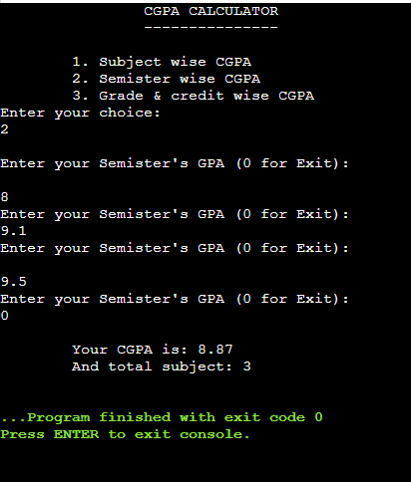
Explanation and code output
If you entered 2nd choice it will ask your each subject’s GPA until you enter 0 .
Result will be Your CGPA along with the total subjects for which you enter.

Slide 5
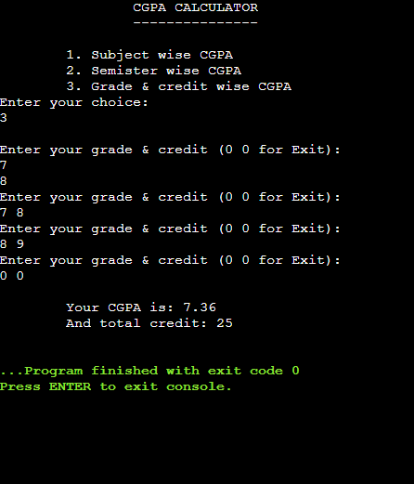
Explanation and code output
If you entered 3rd choice it will ask both your numerical grade and your credit to calculate your CGPA and will also display your total credit score.

Slide 6
Algorithm part 1
1 .Start
2. Declare Variables:double gpa, credit, cgpa = 0, s_cgpa, s_credit = 0, int choice
3. Display CGPA Calculator Header
4. Display Menu Options:
    Subject wise CGPA
    Semester wise CGPA
    Grade & credit wise CGPA
5. Prompt User to Enter Choice scanf("%d", &choice)
6. Loop Until User Exits:
7. While True:
  If choice is 3 (Grade & Credit Wise CGPA):
  Prompt user to enter gpa and credit (0 0 for Exit)
  scanf("%lf%lf", &gpa, &credit)
  If gpa and credit are both 0:
  Break loop
  Update cgpa by adding (gpa * credit)
  Update s_credit by adding credit
  Calculate s_cgpa = cgpa / s_credit

Slide 7
Algorithm part 2
  8. Else if choice is 2 (Semester Wise CGPA) or 1 (Subject Wise CGPA):
  If choice is 2:
  Prompt user to enter Semester's GPA (0 for Exit)
  If choice is 1:
  Prompt user to enter
  9. Subject's GPA (0 for Exit)
  scanf("%lf", &gpa)
  10. If gpa is 0:
  Break loop
  11. Update cgpa by adding gpaIncrement s_credit by 1
  12. Calculate s_cgpa = cgpa / s_credit
  13. Else:Break loop
  Display Final CGPA:
  14. If choice is 3:
  Display Your CGPA is: s_cgpa and total credit: s_credit
  15. Else if choice is 2 or 1:
  Display Your CGPA is: s_cgpa and total subject: s_credit
  16. Else: Display Invalid choice
  17. End

Slide 8
flowchart
Declare Variables
gpa, credit, cgpa = 0, s_cgpa, s_credit = 0
choice
START
Print "CGPA CALCULATOR" Header
Print Menu Options
  Subject wise CGPA
  Semester wise CGPA
  Grade & credit wise CGPA
Input choice
If choice ==3 Print Your CGPA is: s_cgpa and total credit: s_credit
While Loop (True)
If choice == 3: Input gpa and credit
If gpa == 0 and credit == 0: Break loop
Update cgpa += gpa * credit
Update s_credit += credit
Calculate s_cgpa = cgpa / s_credit
Else If choice == 2 or choice == 1
If choice == 2: Print "Enter your Semester's GPA (0 for Exit)“
If choice == 1: Print "Enter your Subject's GPA (0 for Exit)“ Input gpaIf gpa == 0: Break loop
Update cgpa += gpaIncrement s_creditCalculate s_cgpa = cgpa / s_creditElse: Break loop
Else If choice == 2 or choice == 1 Print Your CGPA is: s_cgpa and total subject: s_credit
Else Print Invalid choice
END

Slide 9


application
Academic Reporting Performance Analysis

Slide 10


applications
Scholarships Job Applications and Internships
This Photo by Unknown Author is licensed under CC BY-SA

Slide 11
conclusion
In conclusion, the CGPA calculator code effectively demonstrates how to handle user input, perform calculations, and provide meaningful output based on different scenarios. By offering options for subject-wise, semester-wise, and grade and credit-wise CGPA calculations, the code caters to various needs and preferences of students. The use of loops, conditionals, and arithmetic operations showcases fundamental programming concepts, while the clear and user-friendly interface ensures ease of use. This code serves as a practical tool for students and educators alike, aiding in the accurate assessment and tracking of academic performance. Through its applications, it highlights the importance of programming in solving real-world problems and enhancing educational experiences.

Slide 12

Thank you
Project by :-Arav Desai
Sarvesh Kasar
Ayush Mule
Krish Chand

